Slide 1
Introduction
Adaptive cruise control helps in automatically adjusting the vehicle speed to maintain a safe distance from the vehicles ahead.
This has a direct impact on driver safety, convenience as well as increasing the road capacity by maintaining optimal distance between vehicles and reducing human errors.
The car will automatically adjust the speed and distance from other cars without human touch. However, the driver should be aware of what is happening around the car as the technology is only meant for assisting humans and for their ease of access.
A working model is created by using Arduino UNO Microcontroller, ultrasonic sensor for measuring the distance of the obstacle, LCD to display the speed of the vehicle, and few push buttons to toggle between different functionalities such as increase speed, decrease speed, and set cruise functions.
The entire logic of this project is handled using MATLAB IDE that has a ‘MATLAB Support Package for Arduino Hardware’ add-on installed. This allows the interface established between the Arduino UNO board and the MATLAB software.
The speed data which is available real time is then transmitted to ThingSpeak IOT channel and stored in the cloud for access.

Slide 2
Hardware Components
S.No | Name | Quantity | Component
1 | Arduino Uno Board | 1 | Arduino Uno R3 Kit
2 | Liquid Crystal Display | 1 | 16x2 LCD
3 | Potentiometer for LCD | 1 | 10KOHM Pot
4 | Resistor for LED in LCD | 1 | 1KOHM Resistor
5 | Distance Sensor | 1 | HCSR04 Ultrasonic Sensor
6 | Increase Speed Button | 1 | Tactile Pushbutton
7 | Decrease Speed Button | 1 | Tactile Pushbutton
8 | Cancel Button | 1 | Tactile Pushbutton
9 | Cruise Set Button | 1 | Tactile Pushbutton
10 | Adaptive Cruise Set Button | 1 | Tactile Pushbutton
11 | Breadboard | 1 | Breadboard Full Size
12 | Connecting Wires | As Req | Male to Male Wires

Slide 3
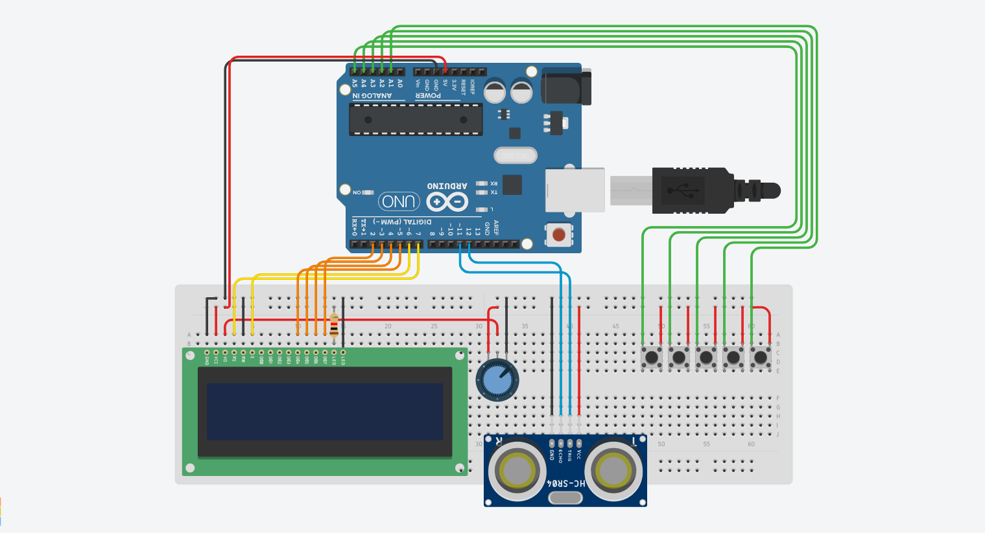
Circuit Diagram

Slide 4
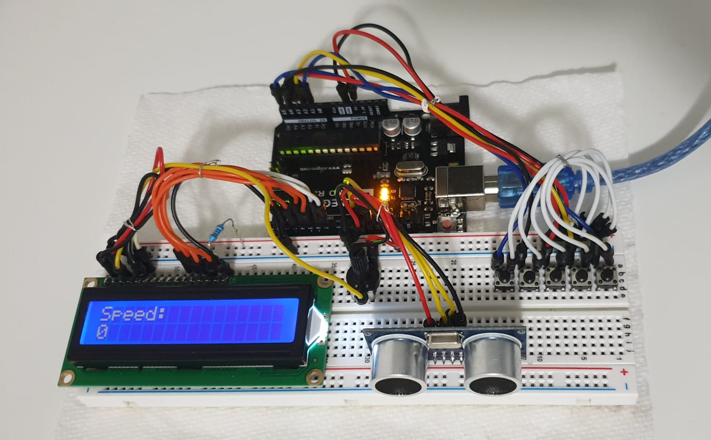
Arduino Setup

Slide 5
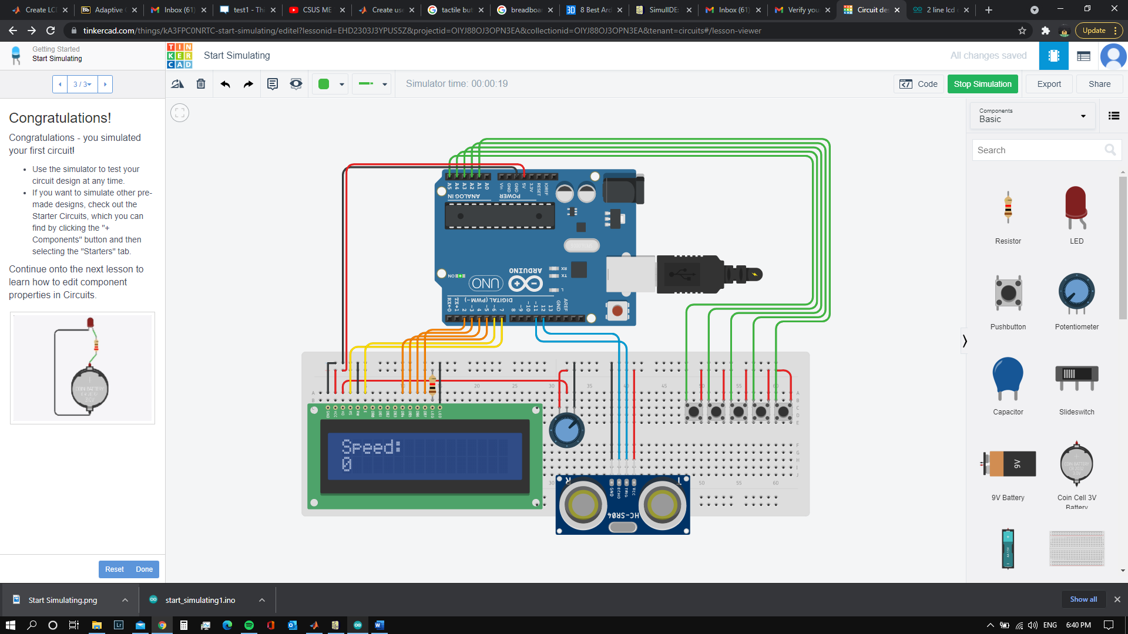
Working Procedure
Case 1: Increase and Decrease
When increase speed button is pressed, speed increases just like when gas pedal is pressed. The speed reduces automatically when the button is released.
The decrease button acts as a brake. The decrease button reduces the speed rapidly when this button is pressed.
Cancel can be pressed from any of the set functions to end the function and reduce the speed to zero automatically.

Slide 6

Working Procedure
Case 2: Set Cruise
When Set Cruise is turned on, the current speed which is displayed in the display is set constant and speed will not reduce automatically.
In cruise mode, the increase speed and decrease speed buttons will work.
Increase speed button will increases the speed from the constant speed and sets a new constant set speed when the button is released.
Decrease speed button will decrease the speed from the constant set speed and sets a new constant set speed when the button is released.

Slide 7

Working Procedure
Case 3: Adaptive Cruise Mode
When adaptive cruise button is pressed once, adaptive cruise control is turned on and the current speed is set and new constant set speed.
This mode incorporates the use of ultrasonic distance sensor to calculate the distance between the car and the object in front of the car and adjust the speed accordingly.
When an object or any other car is near to this car, the speed will reduce accordingly and eventually reduce to zero if the object in front of the car is stationery.
The speed will increase automatically to the constant set speed when there is no obstruction.

Slide 8
Working Procedure
Cloud Connectivity:
ThingSpeak is an IOT platform which allows us to collect and visualize live real time data in the form field charts in the cloud. It also allows us to analyze the data and send alerts. ThingSpeak has integrated support from Matlab to perform the analysis of data in the cloud.
A new channel is created in the ThingSpeak IOT platform, and the required number of fields are set. In our case we are going to save the speed data in cloud and visualize the data for analysis.
After creating fields, channel ID and write API key are copied from the platform and integrated in to the Matlab code which enables the transmission of live data stream to the cloud.
When the speed data is available, thingSpeakWrite command will transmit the data from Matlab to the cloud storage where the data is visualized and presented in graph for analysis.

Slide 9
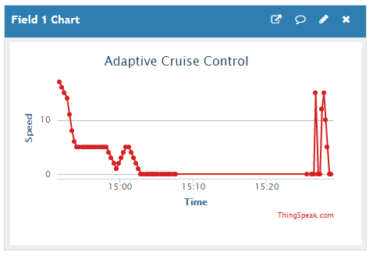
Working Procedure
Cloud Connectivity:
Matlab code: response = thingSpeakWrite(Channel_ID,data,'WriteKey',API_ID);
ThingSpeak IOT Platform Field Chart

Slide 10
Matlab Arduino Interface
Download and install Hardware Support Package for Arduino Hardware and install all the required libraries.
Connect the Arduino and install the USB driver when prompted by the hardware package.
The code will be uploaded to Arduino when the code is run in Matlab.
Matlab Code

